Slide 1
The appliance of science – opportunities in food lessons

Slide 2
“Cooking isn’t just an art; it is a science”. The process of cooking, baking, and preparing food is essentially an applied science.

Slide 3
Why food science?
What is it and why is it important?
“Food science: The study of the basic chemical, physical, biochemical, and biophysical properties of foods and their constituents, and of changes that these may undergo during handling, preservation, processing, storage, distribution, and preparation for consumption.” (Encylopedia.com)
Food science is a multidisciplinary field of study (and practice) that involves applying chemistry, nutrition, microbiology, chemical engineering, and physics to food, food groups, and the food system.

Slide 4
Why teach the science of food?
Provides practical links to the science of food and cooking through the food pupils buy, cook and eat.
Enables pupils to relate to science through everyday examples and hands-on activities and experiences.
Explores the principles of food science through practical cooking.
Supports and reinforce knowledge through related experiments alongside practical cooking.
Enables pupils to ‘make the connections between theory and practice so that they are able to apply their understanding of food and nutrition to practical cooking’ 14-16 ‘food’ specifications.

Slide 5
What should you consider?
Food science includes chemistry, microbiology, nutrition, biochemistry, physics.
The ways of categorising and integrating the science into food education.
How the scientific concepts will underpin your learning intent.
How you will build in progression in your Schemes of Work/Learning

Slide 6
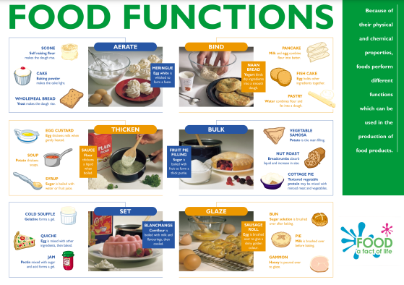
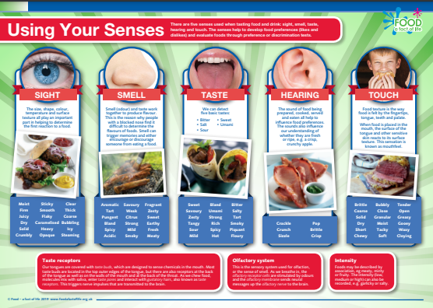
Aspects of food science
Cooking: why we cook food, heat transfer
Microbiology of food: safety, production
Nutrition science
Sensory science: taste, texture, flavour, (including enhancers) appearance and the interrelationship with changes when cooked e.g. Maillard reaction
Physical and chemical properties
Food functions
Using your senses

Slide 7

The science of food Topic hub
A series of Topic hubs bringing Food - a fact of life resources and support together in one place!
Active learning
Recall, retrieval and revision
Everything for teaching about the Eatwell Guide
Why food careers matter and how teachers can lead the way
British Science Week

Slide 8
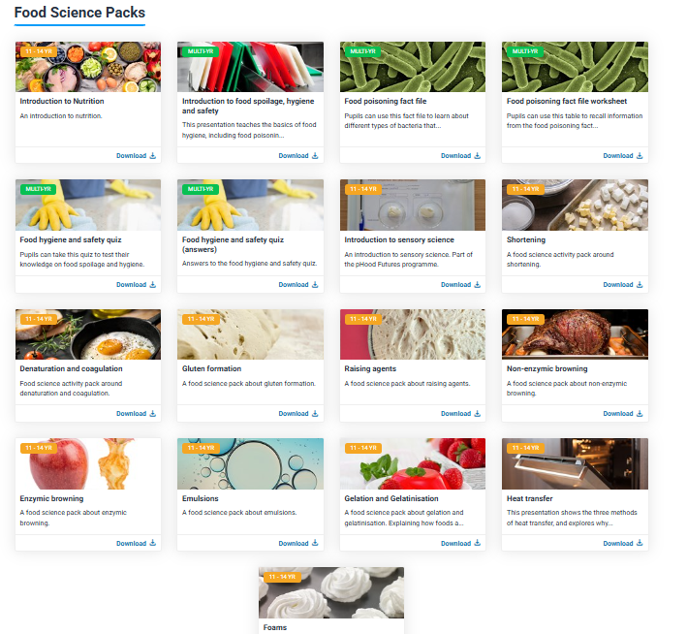
Science through the context of food resources
Teaching materials that link core science concepts to everyday life through food
Designed to enhance existing curricula or support extra-curricular activities (e.g. drop-down days, STEAM clubs)
Four activities focused on parental engagement, suitable for home or school use
Guidance to inspire pupils to consider science-based career pathways
Resources for food teachers and their science colleagues!
Science through the context of food

Slide 9
Classroom activities

Slide 10

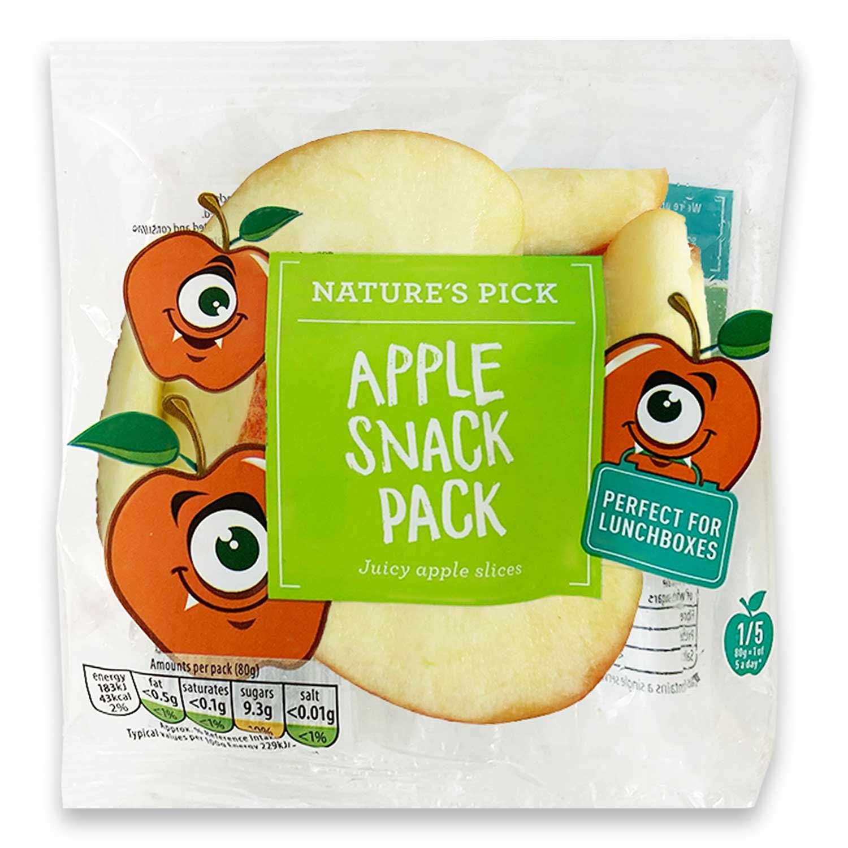
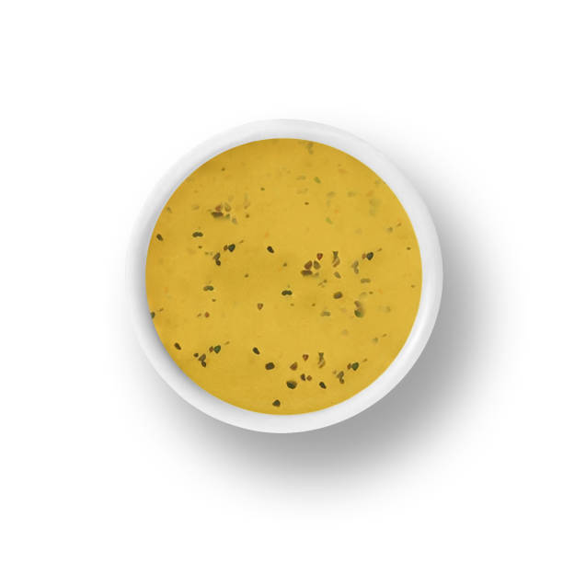
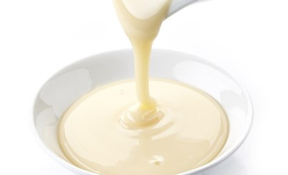
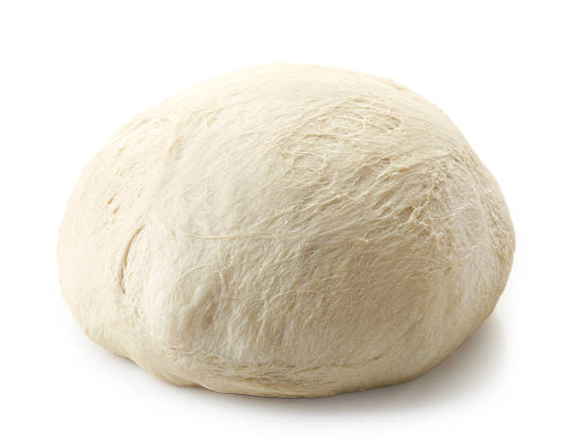
Quick and simple?
What’s in the pack?
Why does it separate?
Why no lumps?
Why is it stretchy?

Slide 11
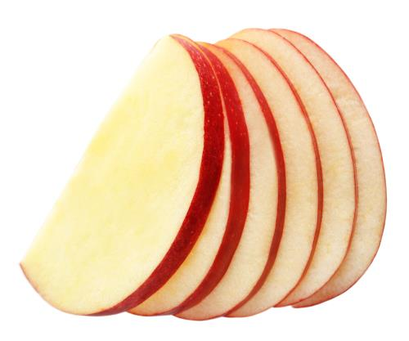
Activities and experiments/investigations
Discussion:
How do manufacturers prevent pre-packed fruit from browning?
Packaged apples are usually treated with a solution of calcium ascorbate (a blend of calcium and vitamin C) or citric acid to maintain freshness and colour.
Packaging technologies used to prevent oxygen from coming into contact with fruit by replacing it with nitrogen.
Discussion:
Compare the cost of an apple and the cost of a prepared apple snack pack. Why is it more expensive?
Where does the apple/fruit come from? Local? Seasonal?
How is it packed? Can the packaging be recycled?

Slide 12
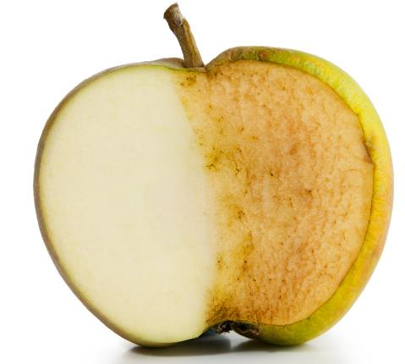
Enzymic browning
How do enzymes discolour fruit?
Phenols are stored inside fruit cells.
When the cell is cut or bursts, they are released.
An enzyme (polyphenol oxidase) is released from the damaged cell turns the colourless phenols into brown pigments.
How can it be stopped?
Only cooking (90°C and above) will deactivate the browning enzyme e.g. blanching.
Lemon or pineapple juice both contain antioxidants and are acidic reducing the enzyme activity and browning.
Keeping fruit under water/syrup and chilling/freezing slows down reactions.

Slide 13
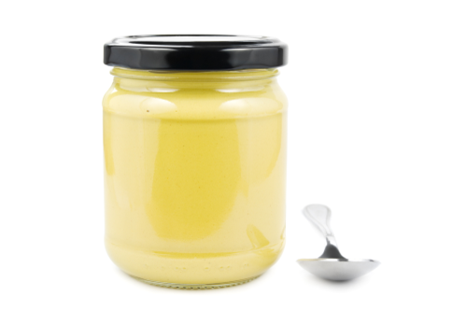
Activities and experiments/investigations
Teaching points:
Explain why oils and water are immiscible (do not stay mixed).
Explain how an emulsifier works.
Describe some common emulsifiers found in foods.
Demonstrate how emulsions can be formed, using examples (e.g. vinaigrette).
Activity:
1. Pour 50ml of vinegar into the jar. Add the oil. Wait to see what happens to the two liquids.
2. Secure the lid. Shake for 15 seconds. Note what happens.
3. Repeat the process. Place the vinegar in the jar with the mustard and mix.
4. Slowly drizzle the oil into the vinegar and mustard mixture whisking all the time.
5. Leave for a few seconds and note what happens. Did the same thing happen with this mixture?

Slide 14
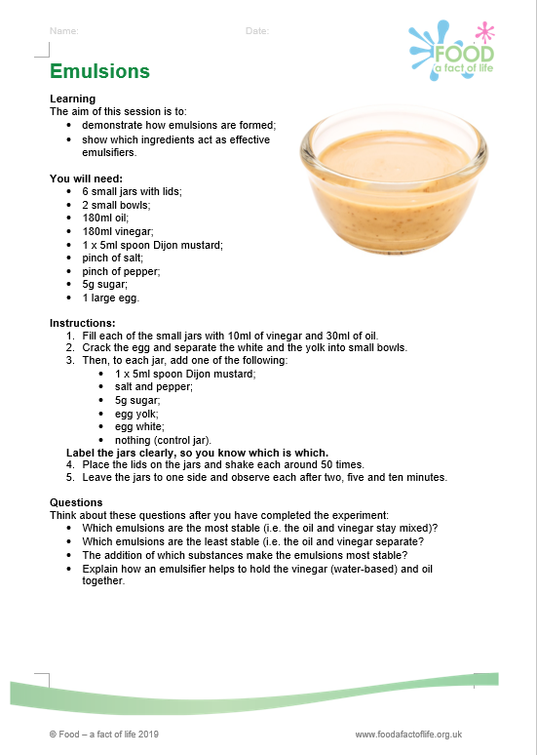
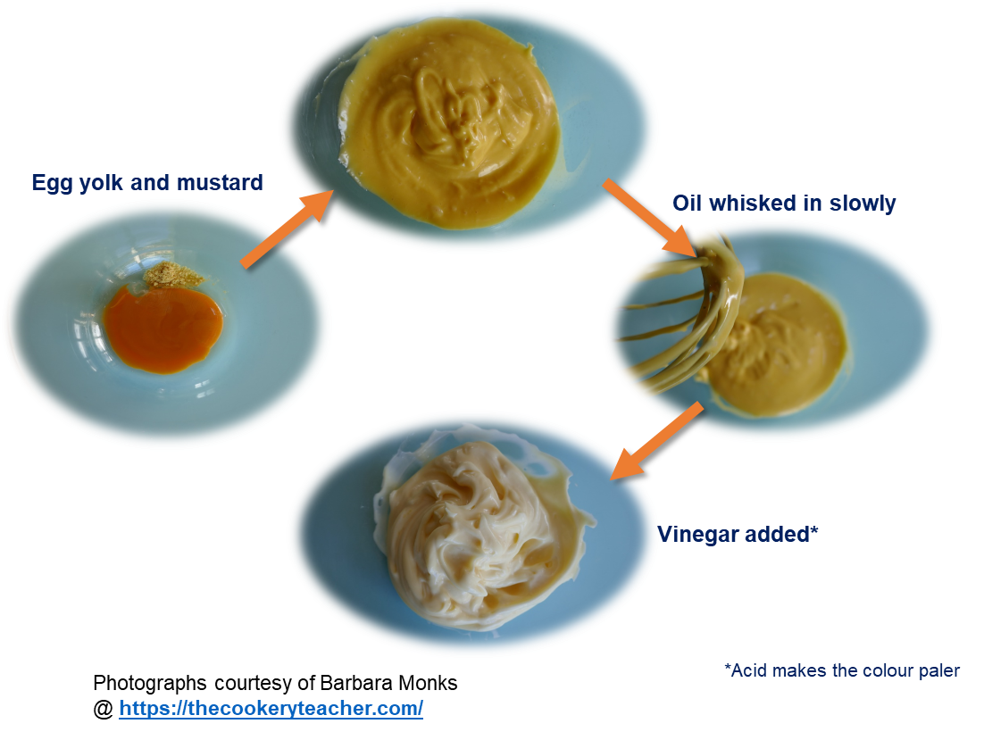
Activities and experiments/investigations

Slide 15
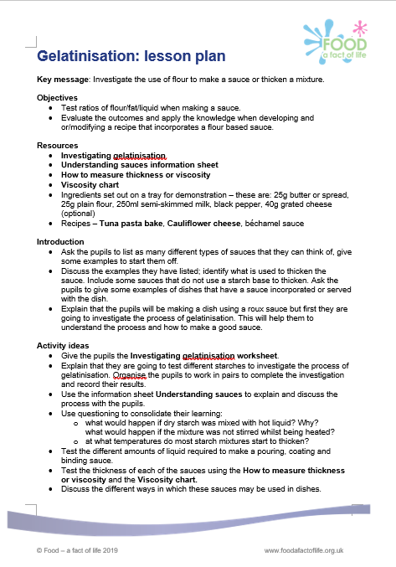
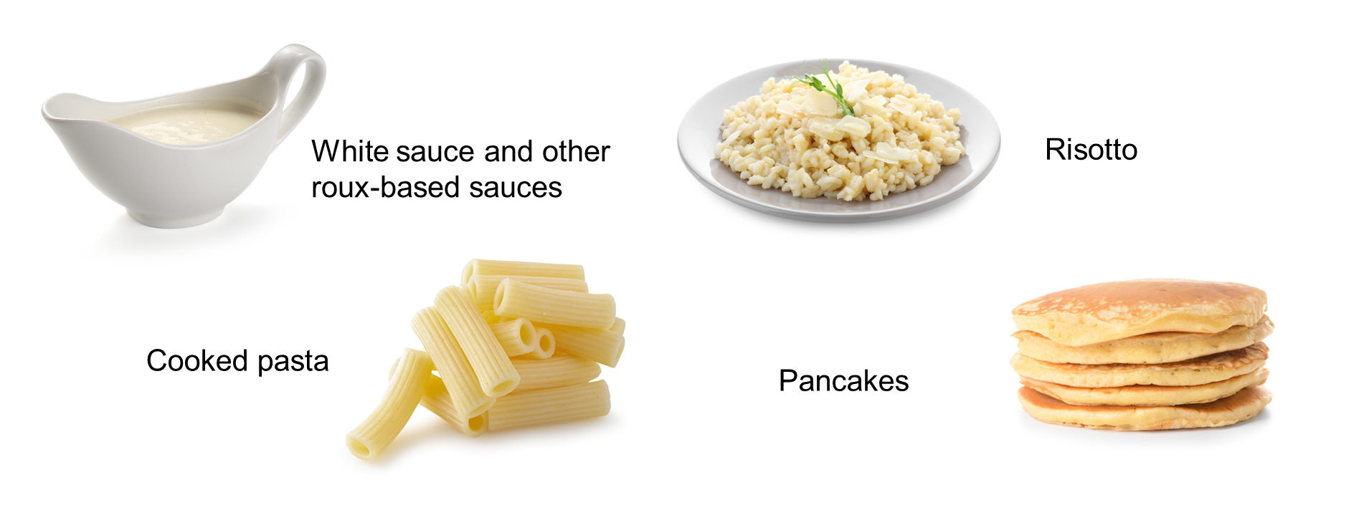
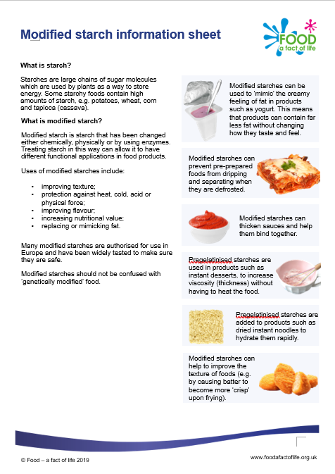
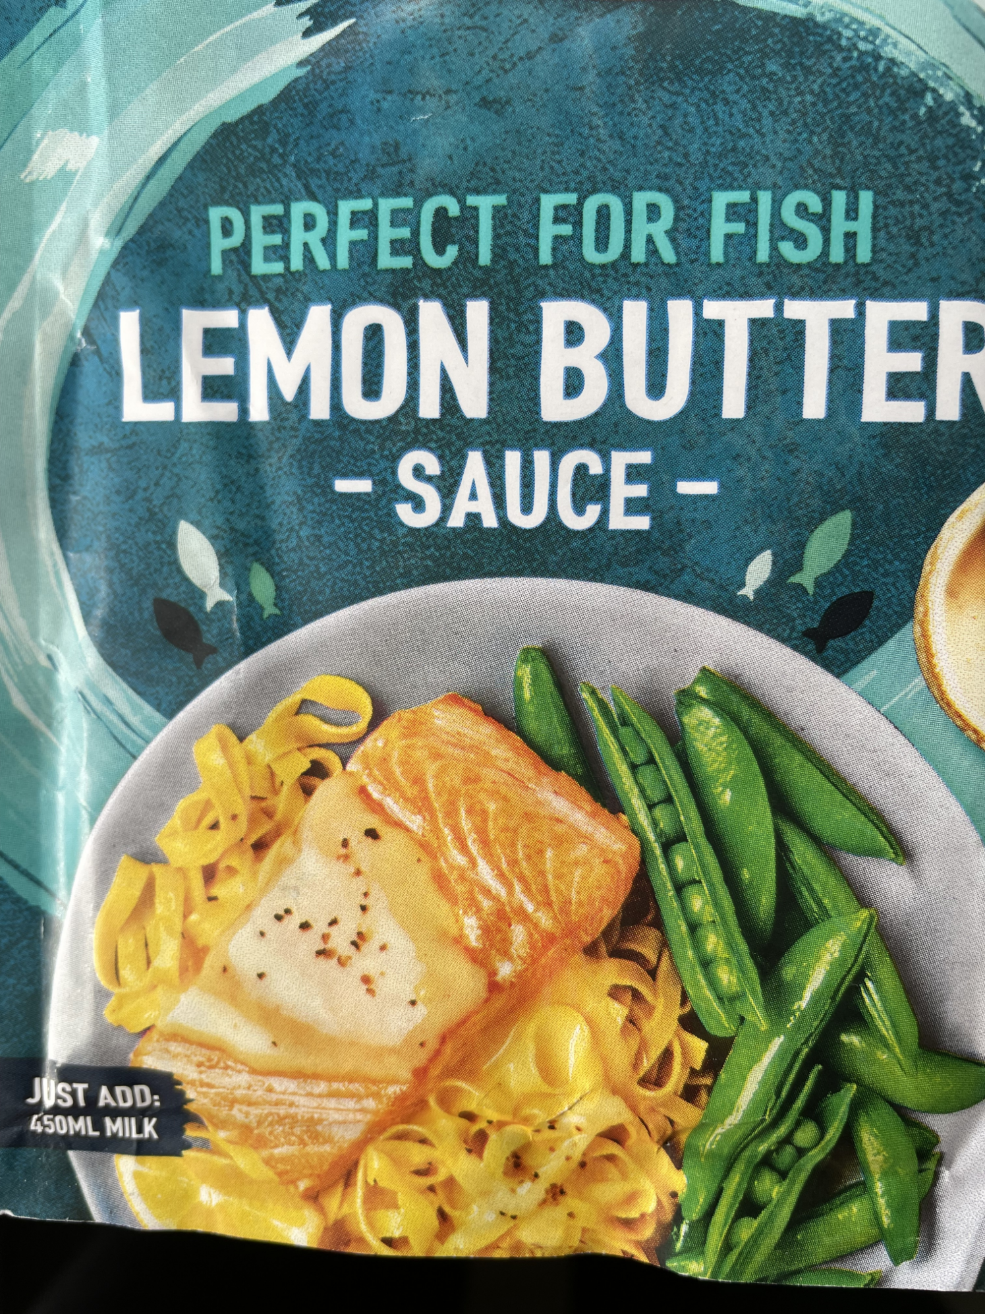
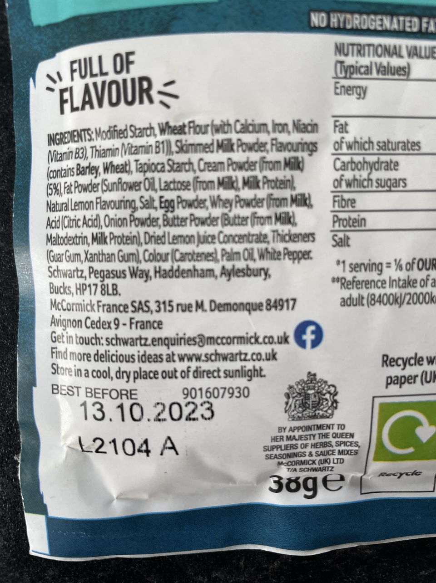

Activities and experiments/investigations

Slide 16
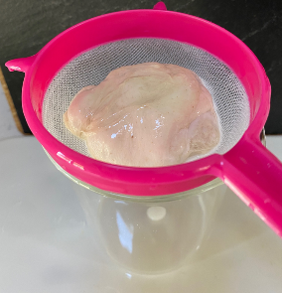
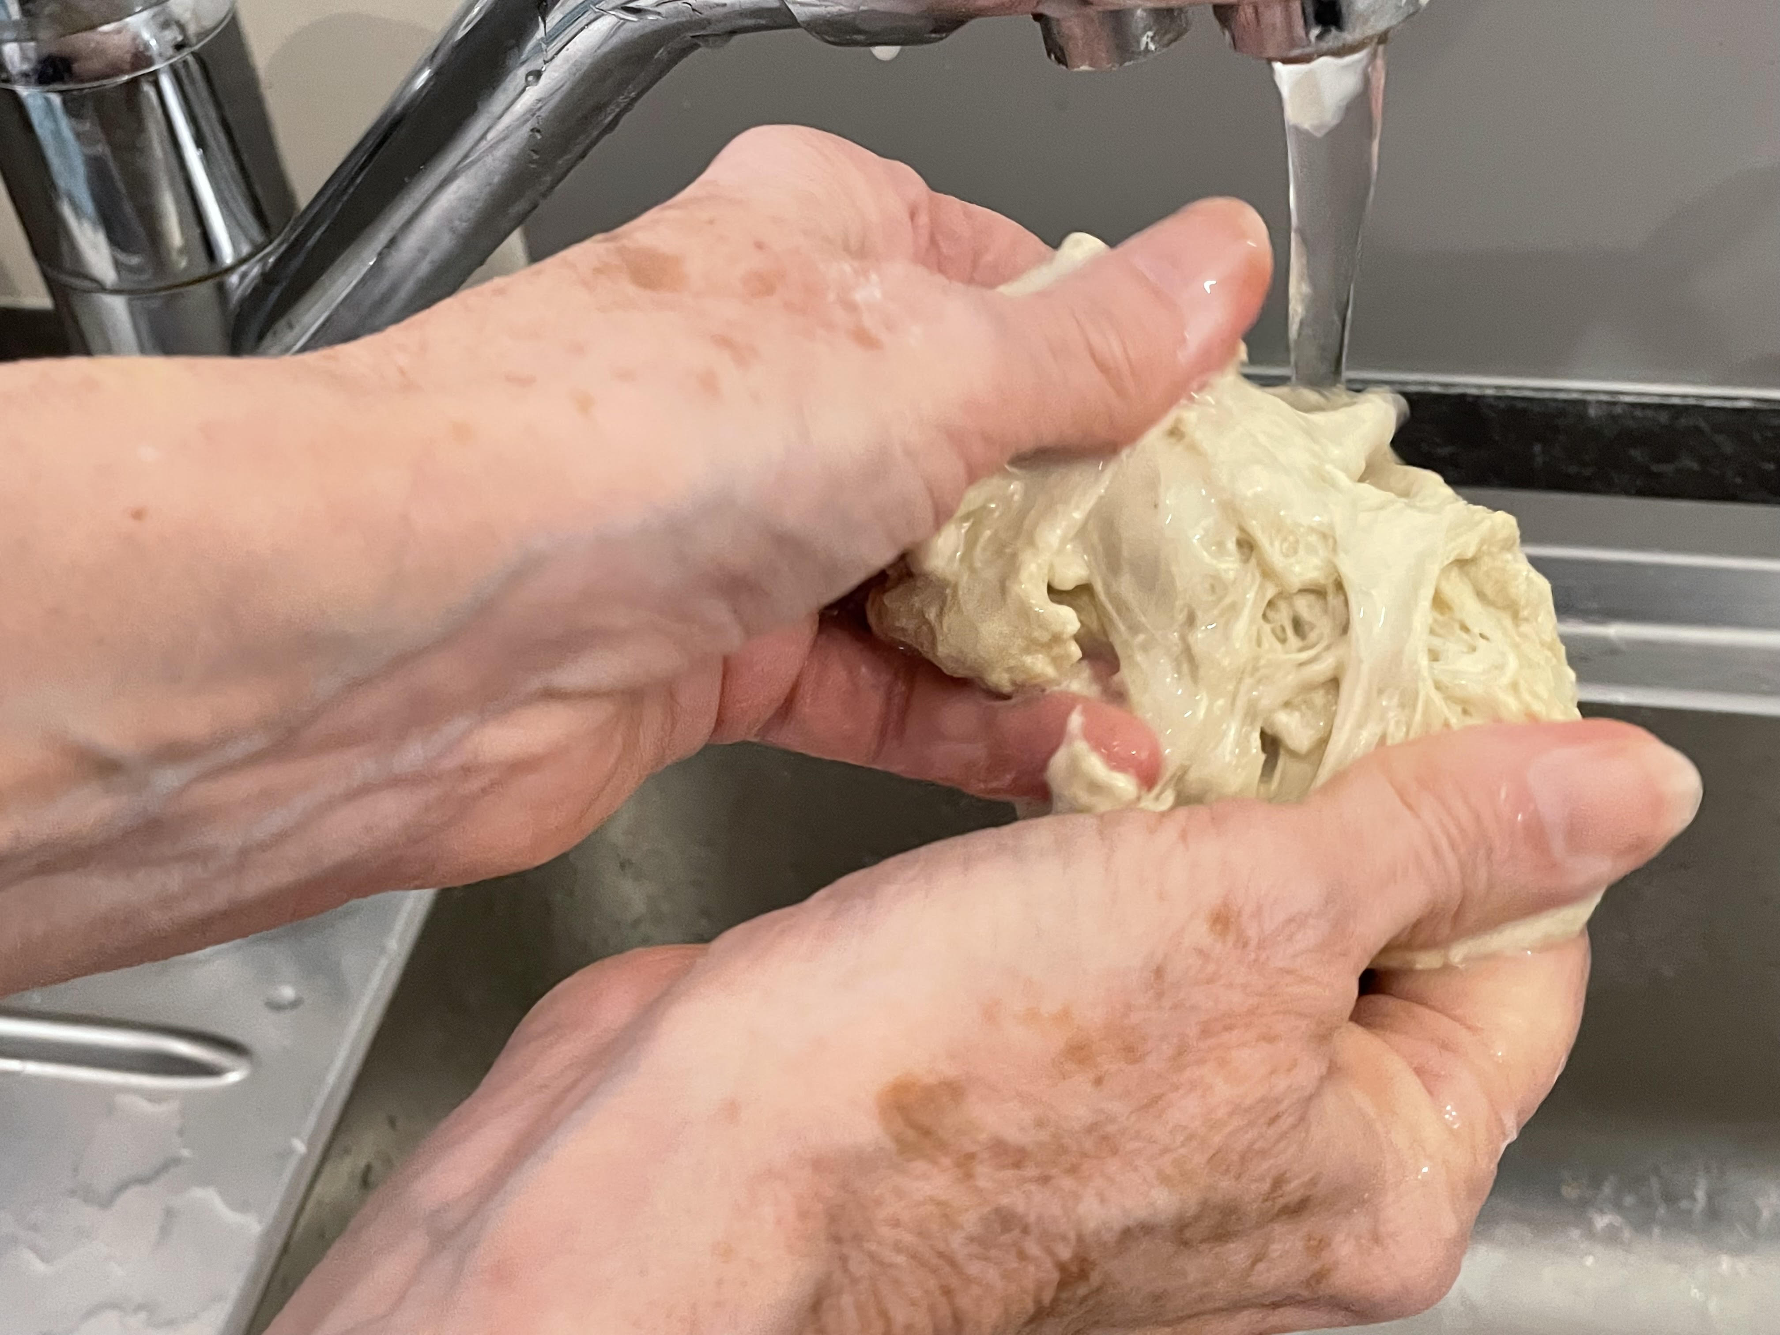
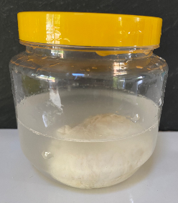
Activities and experiments/investigations
What is the best way to make gluten balls?
Wash under running water
Wash in a large sieve
Wash in large plastic jar
Top tips
If you are short of time, make up a batch of dough using the food mixer and dough hook.
When baking the gluten balls, line the tray with non-stick/greaseproof paper.
If the gluten is taken out of the oven too soon, it will collapse as the protein has not coagulated fully.
Photos by Barbara Monks
www.thecookeryteacher.com

Slide 17
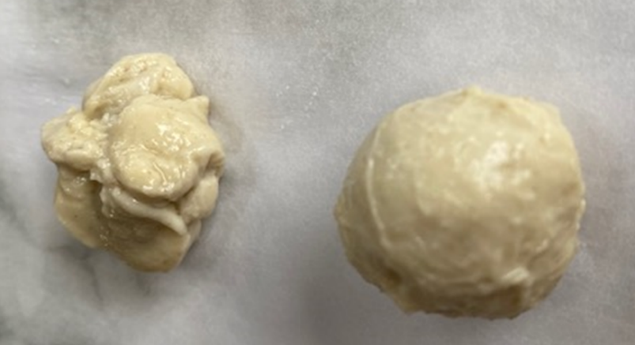
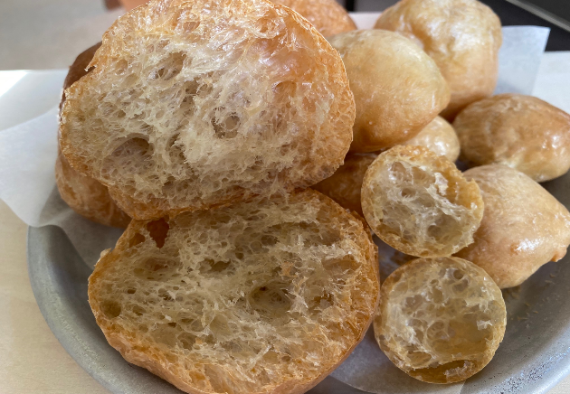
Gluten ball samples
Raw gluten
Baked gluten
Photos by Barbara Monks
www.thecookeryteacher.com
Notes:
Rice, potato, cornflour do not contain gluten

Slide 18
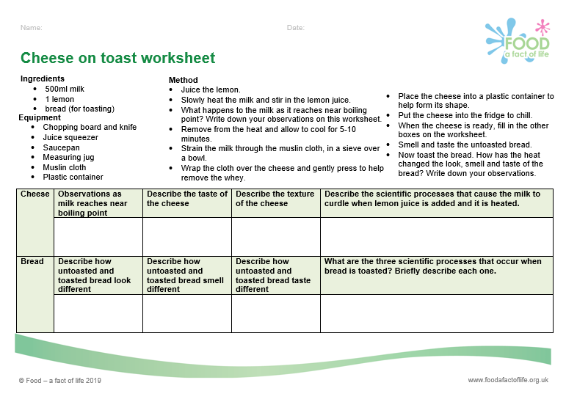
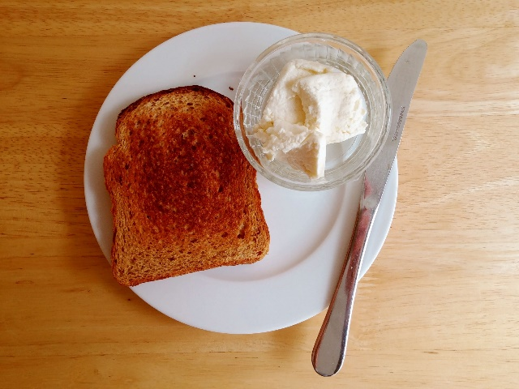
Practical activity – the science of cheese
Why do this?
Learning in lesson: focus on skill/knowledge, not recipe.
Made and evaluated within an hour, ideal for shorter lessons.
Alternative methods can be used to extend activity, e.g. Twarog to make Gzik
Uses ingredients that are easy to source, inexpensive and mostly stored at ambient temperatures.
Food science: Denaturation, coagulation, heat transfer.
Nutrition science: Dairy and starchy carbohydrates in the diet.
Sensory science: Testing, tasting and evaluation.

Slide 19
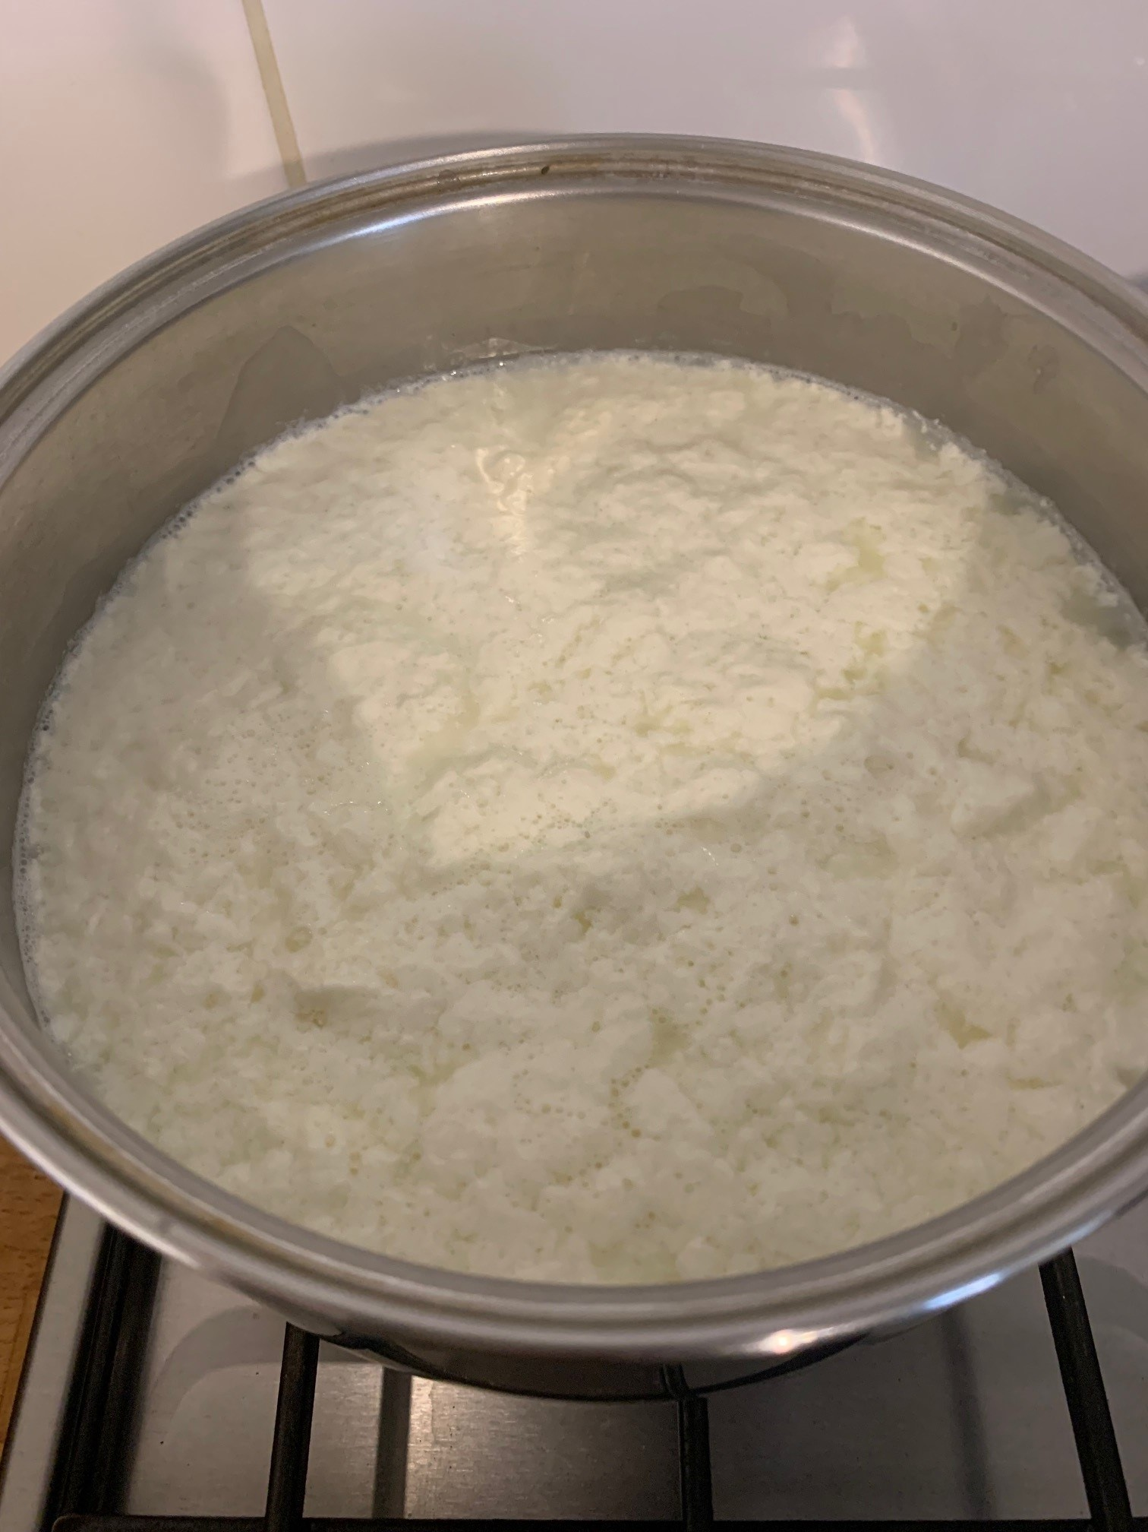
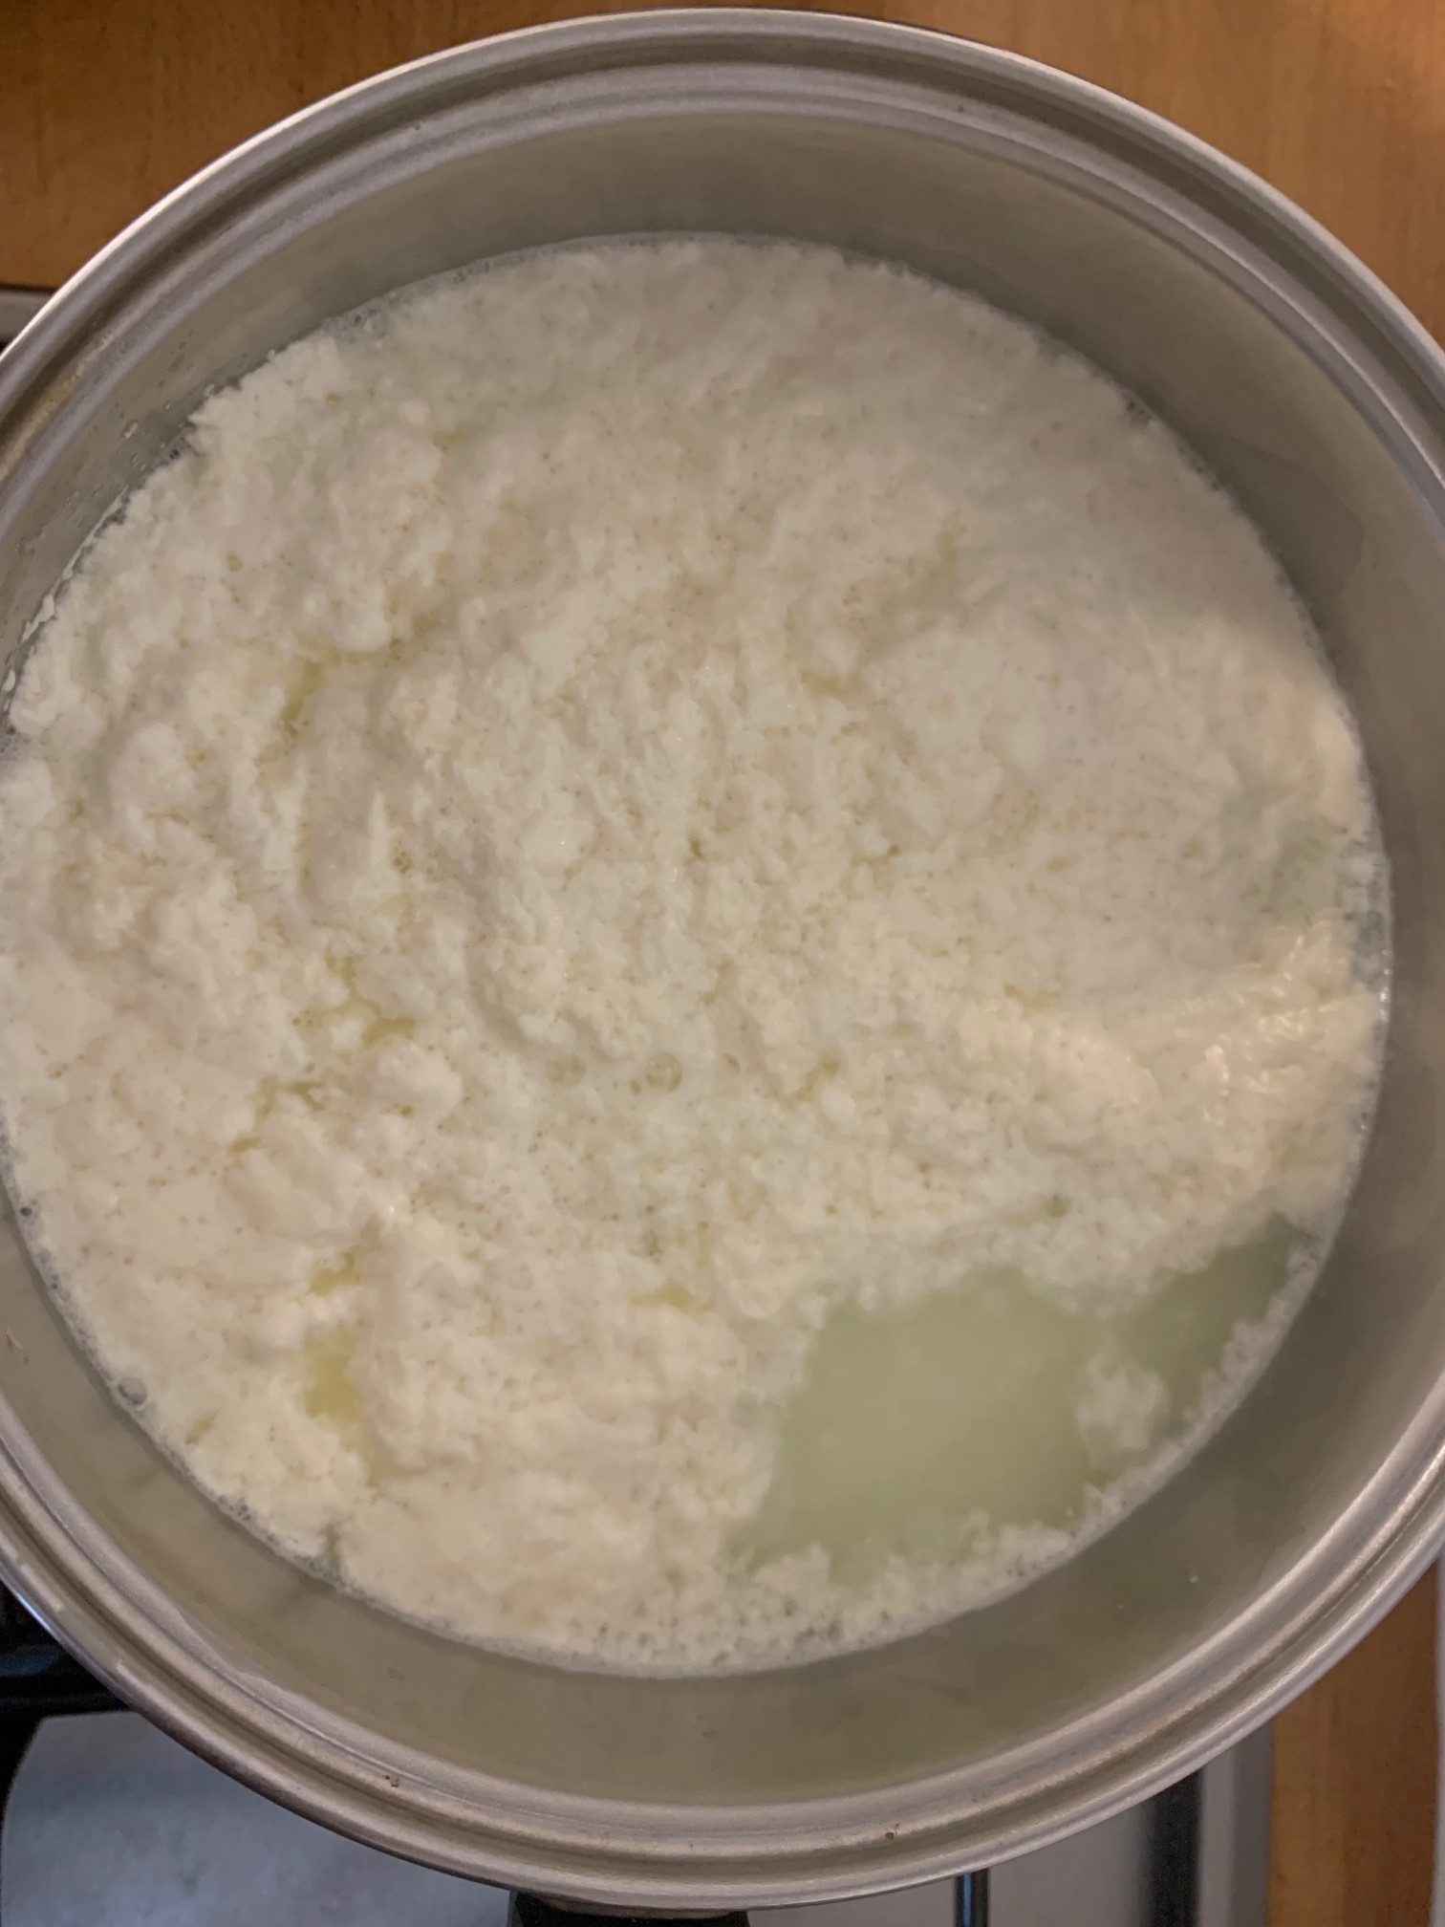
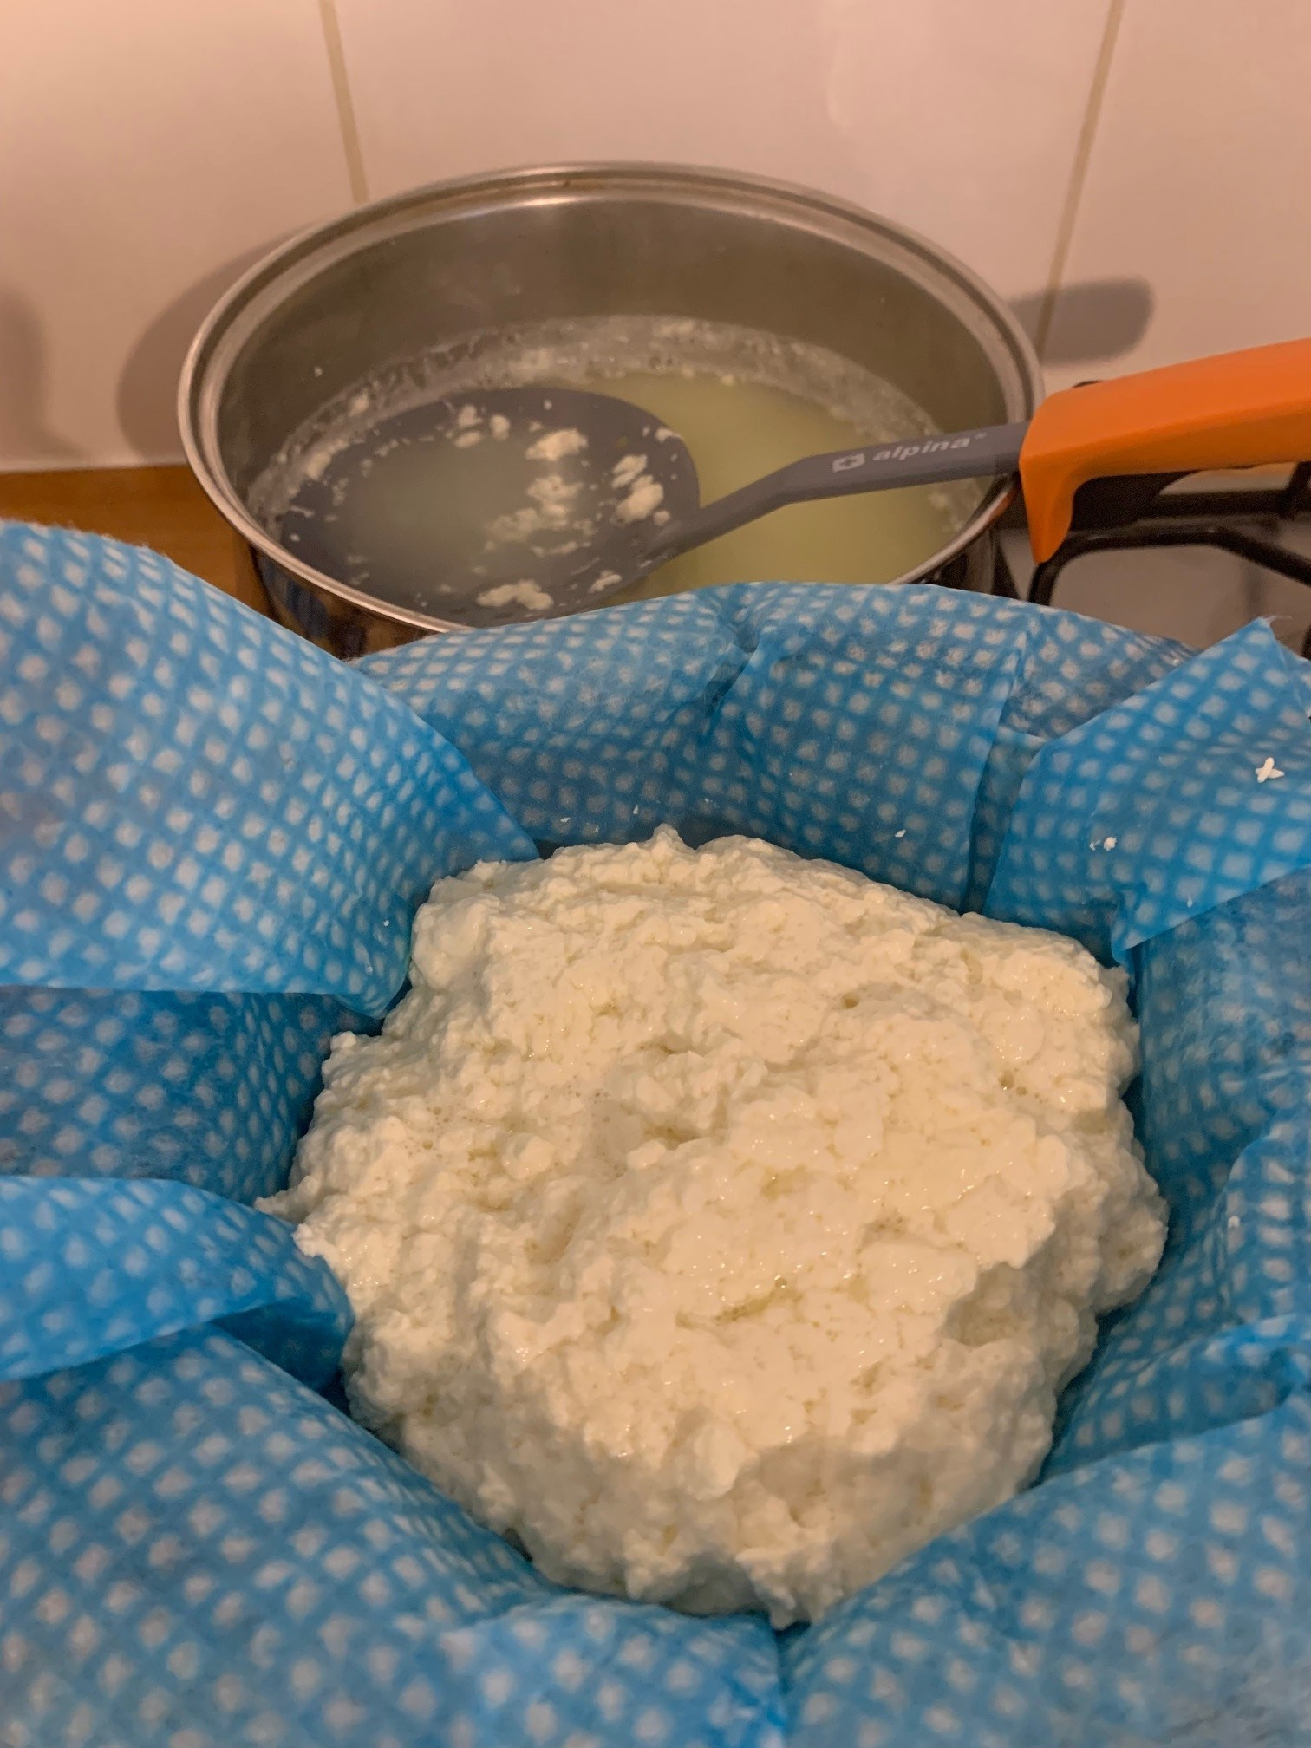
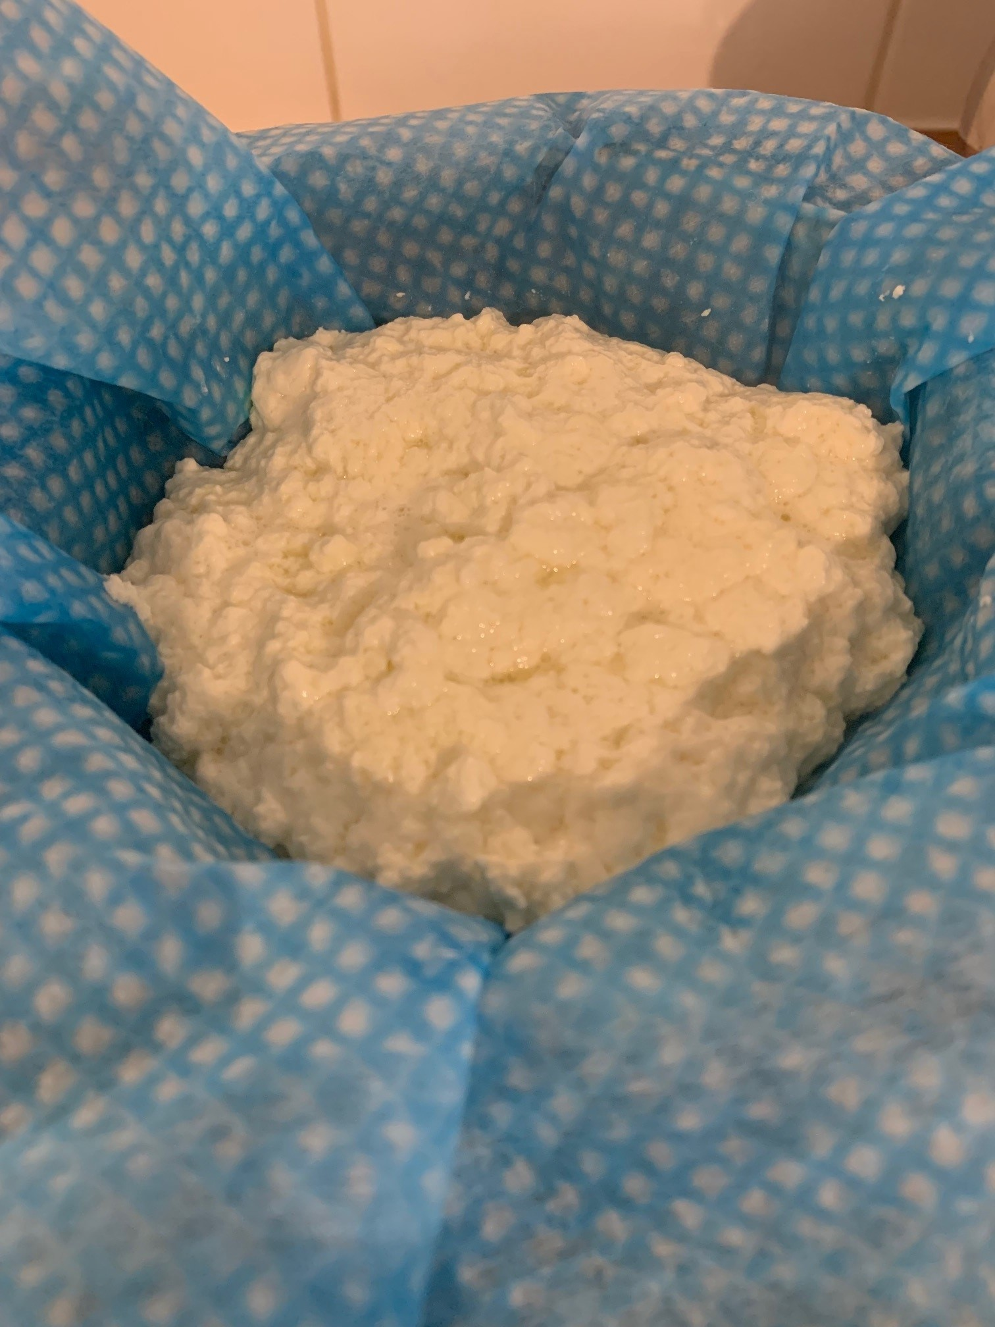
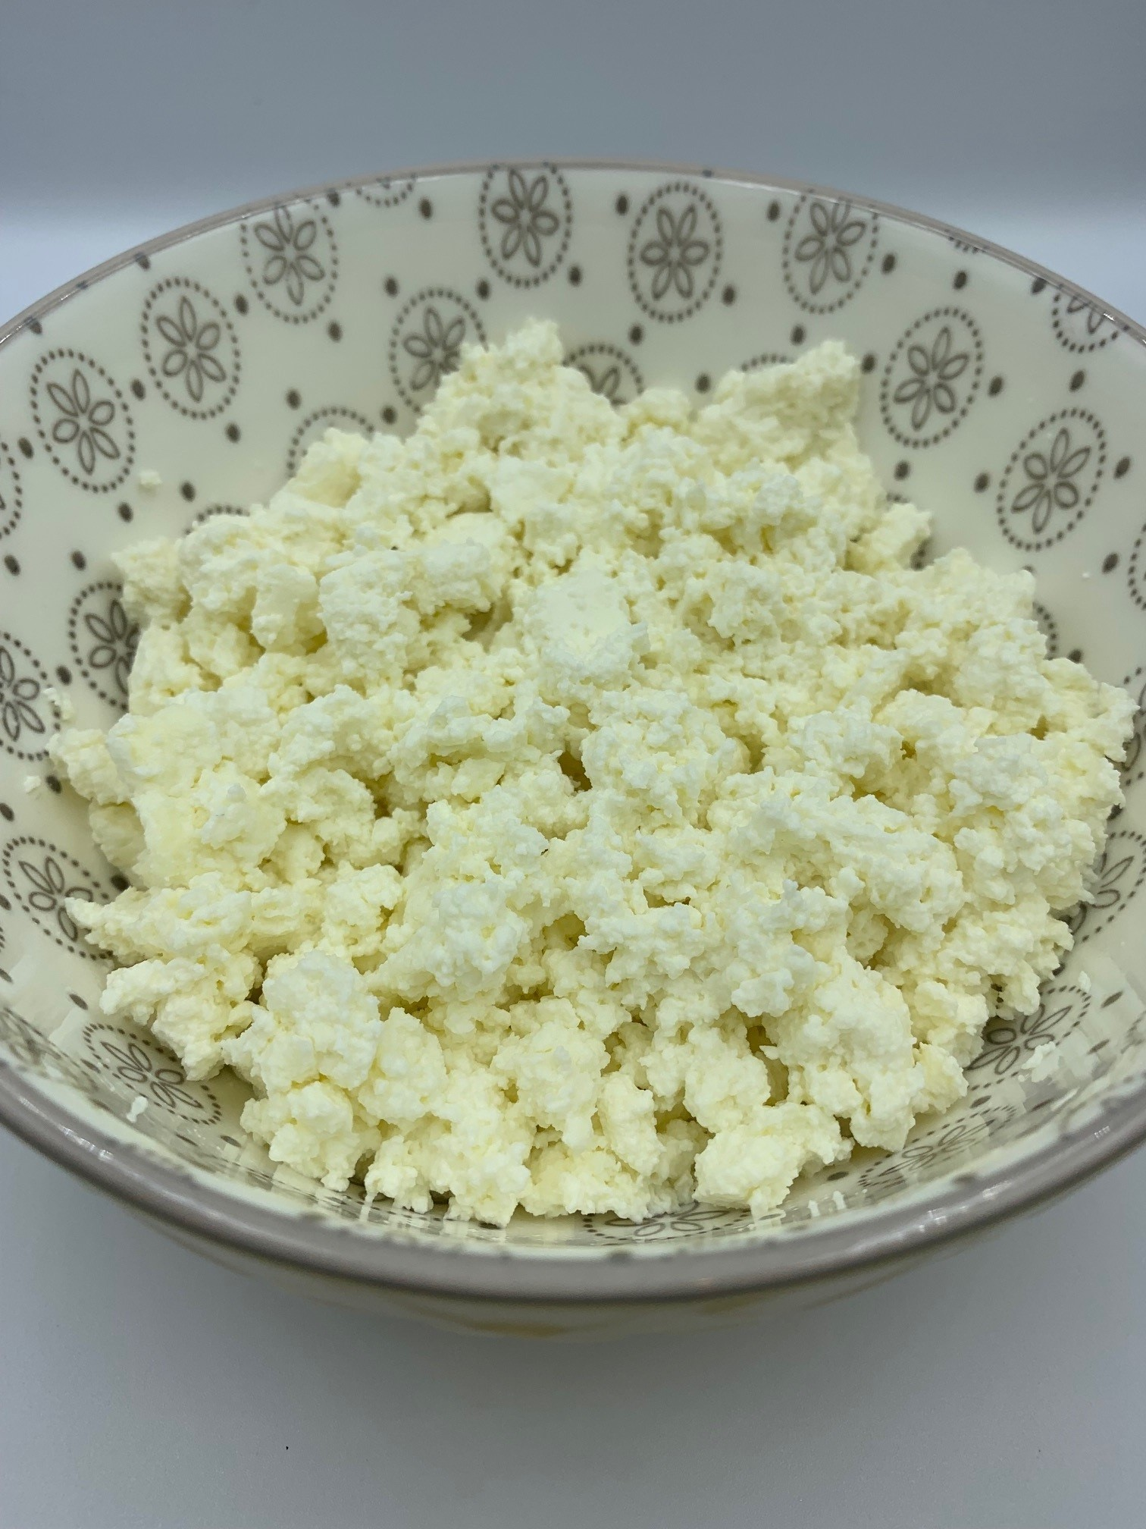
Making homemade cottage cheese
When lemon juice is added to milk it curdles, a process of coagulation. The pH of milk is 6.8 and that of lemon is 3.5 due to the presence of citric acid. As the pH of the milk drops by adding lemon, the milk curdles i.e the casein protein molecules attract one another, forming curds.
When kefir, buttermilk or yogurt is added to milk, the lactic acid present also increases the acidity of the milk, resulting in coagulation of the casein and forming curds.

Slide 20
Cream/curd cheese
Ingredients
500ml whole milk
1 large lemon (approx. 50ml juice – this can be from a bottle)
Method
Juice the lemon.
Slowly heat the milk and stir in the lemon juice when it reaches 37°C.
What happens to the milk as it gets warmer? Write down your observations on this worksheet.
Remove from the heat at about 50°C and allow to cool for 5-10 minutes.
Strain the milk through the muslin cloth*, in a sieve over a bowl.
Wrap the cloth over the cheese and gently press to help remove the whey.
Place the cheese into a small container to help form its shape.
Put the cheese into the fridge to chill.
When the cheese is ready, fill in the other boxes on the worksheet.
Equipment
Chopping board – if using a fresh lemon
Knife – if using a fresh lemon
Juice squeezer – if using a fresh lemon
Saucepan
Measuring jug
Digital food probe
Muslin cloth or ‘J cloth’ (if available)
Sieve
Bowl
Small container
*If you don’t have a muslin cloth, just use a fine sieve

Slide 21
Twarog (homemade cottage cheese)
Ingredients
1.136 litres (2 pints) fresh, full fat milk
225g kefir, buttermilk or natural yogurt
These ingredients can be halved for a smaller quantity of cheese.
Method
Pour the milk into a large saucepan and heat for a few minutes over a medium heat.
When it is warm, reduce the heat to low.
Add the kefir, buttermilk or yogurt and mix gently.
Heat until you notice the separating whey.
Remove the curds with a slotted spoon and place in a sieve lined with muslin, cheesecloth or a clean dish cloth.
Leave to drain any remaining whey.
Store in the refrigerator.
Use your homemade cottage cheese to make Gzik.
Use whole or semi skimmed milk not UHT.
Note: If using buttermilk, it will take longer than kefir or natural yogurt to form curds and whey. The resulting cottage cheese will also be softer in texture.
Notes:
Twaróg (also known as Polish-style Farmer’s Cheese) is a type of white fresh cheese. It’s a firmer and drier variety of Quark – although the flavour is quite unique and it’s hard to compare it to any other cheese.
This cheese is essential to Polish cuisine, it’s a key ingredient of many classic dishes including (but not limited to):
Breakfast bread spreads/pastes
‘Gzik’ – a creamy dip, mixed with cumin, spring onion and dill.
Various fillings, e.g. for Sweet Cheese Pierogi, for Potato and Cheese Pierogi, or for ‘Naleśniki’ (Polish-style crêpes)
Desserts: Cheese Yeast buns (‘Drożdżówki’), Cheese Babka, Cheesecakes, Easter Pascha
Dough for dumplings (e.g. ‘Leniwe’ dumplings)
Milk + cultures = lacto-fermentation creates curds and whey - save the whey for smoothies, soups, or bread making. Acid (lemon juice/vinegar) curdles the milk creating a different texture
Lactobacillus bacteria convert sugars naturally present in food (including fruit or vegetables) into lactic acid.
Farmer’s Cheese loses freshness very rapidly, Twaróg absorbs other smells easily. To prevent that from happening, store the cheese in a container, tightly covered with a lid. Refrigerate for a maximum of 4-5 days.
Kefir is a cultured, fermented milk drink, originally from the Caucasus Mountain region that divides Asia and Europe. It is similar to yogurt but thinner in consistency. It has a tart, sour taste and a slight ‘fizz’, due to carbon dioxide – the end product of the fermentation process. The length of the fermentation time determines the flavour. It can be used in the same way as milk/yogurt, as the base for dips/marinades and in baking. Due to its acidity, it can be used instead of buttermilk to make soda bread.

Slide 22
Cheese on toast
When the cheese is ready, fill in the other boxes on the worksheet.
Smell and taste the untoasted bread.
Now toast the bread. How has the heat changed the look, smell and taste of the bread? Write down your observations.

Slide 23
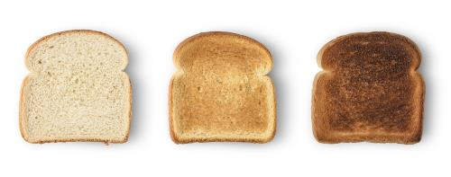
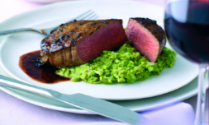
Dextrinisation and Maillard reaction
Dextrinisation
During the (dry) heating process, starches within food are broken down by a chemical reaction into sugars called dextrin.
Dextrins are brown in colour and have a distinct taste and consistency.
Dextrinisation happens when bread is toasted, cakes and biscuits are baked.
Maillard reaction
The Maillard reaction creates flavour and changes the colour of food.
It is a chemical reaction between an amino acid (found in proteins) and a reducing sugar, usually requiring the addition of heat.
This is called non-enzymic browning.
The reaction gives complex flavours to many foods such as roast meat or roasted coffee beans. Associated with roasting, baking and frying.
Notes:
Dextrinisation – starch molecules break down into smaller groups of glucose molecules after being exposed to dry heat causing the food to develop a brown colour
Caramelisation – when heat (moist or dry) changes the colour, flavour, and texture of sugar.
Gelatinisation – when moist heat is applied to starch. The starch gains swell and burst, releasing amylose, which thickens the mixture around boiling point.
Maillard reaction - The optimum temperature for this reaction ranges from 140C to 165C. Note that caramelisation is not a Maillard reaction (no protein).
Three things must be available: amino acids, reducing sugars, and water.
Reducing sugars such as glucose and fructose react with a free amino acid or part of a protein chain.
Unstable intermediate structures called Amadori compounds are formed that are initially flavourless and colourless.
New flavour compounds called dicarbonyls are created.
Hundreds of by-products that impact flavour, aroma, and colour continue to form.
Brown melanoidin pigment molecules form, responsible for many colours on the surface of foods.
High-heat methods like roasting, baking, pan-frying, deep-frying, grilling, searing, braising, and stewing benefit from this process.
A small amount of moisture is needed in the food from a molecular level to help the browning process, although too much can impair it. The key is to ensure the food’s surface is dry to prevent steaming and promote the maximum amount of browning.

Slide 24
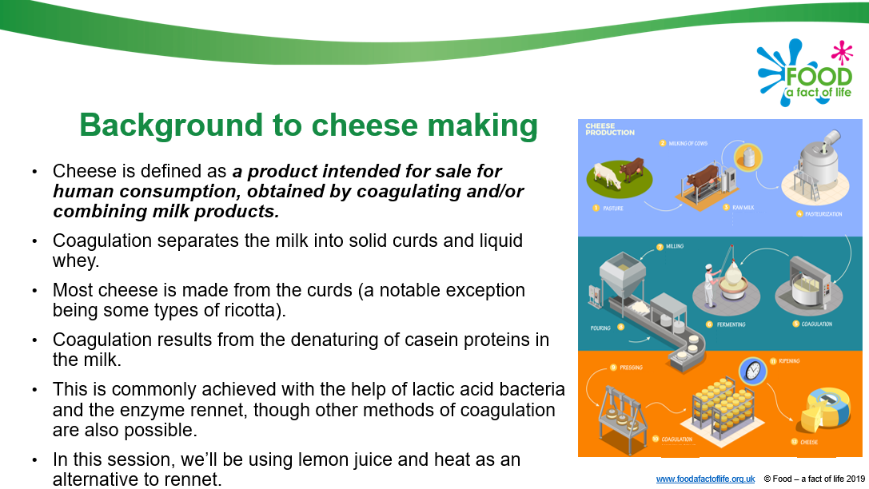
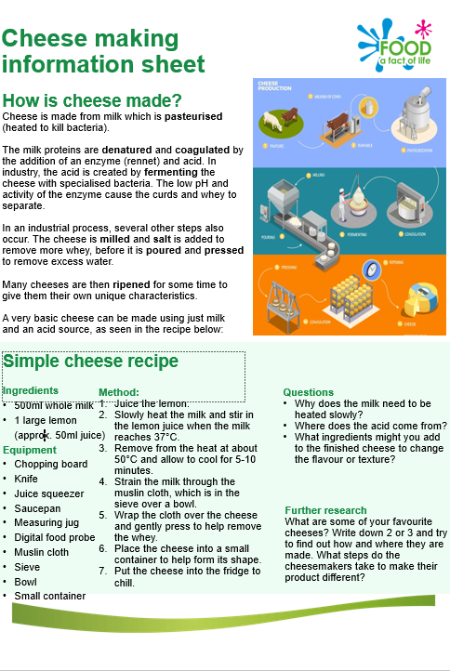
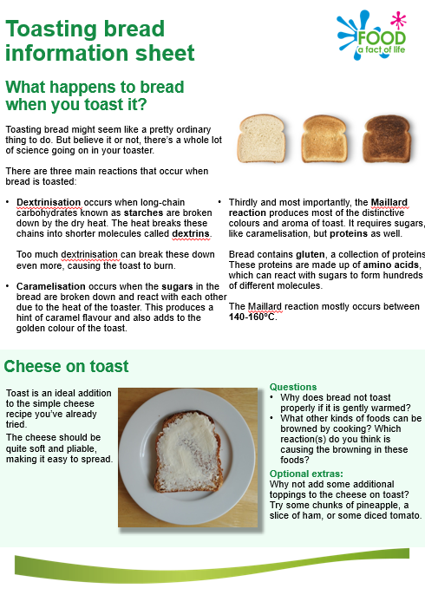
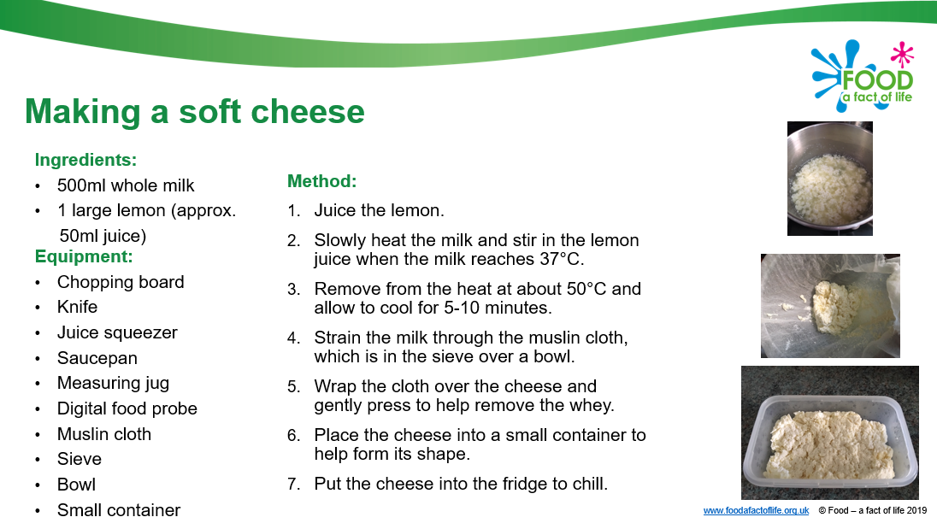
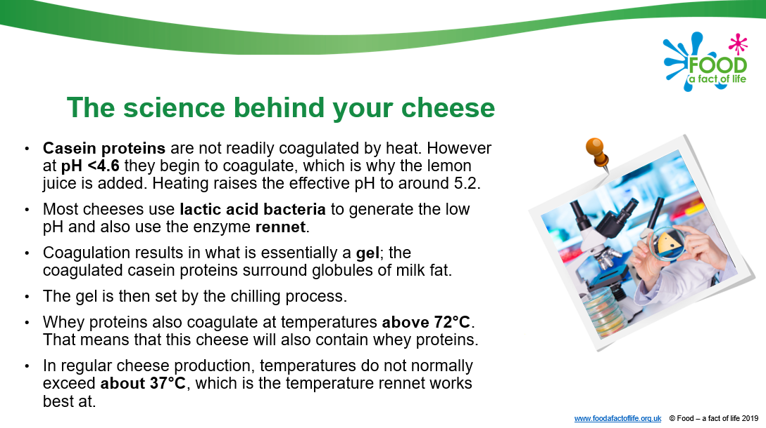
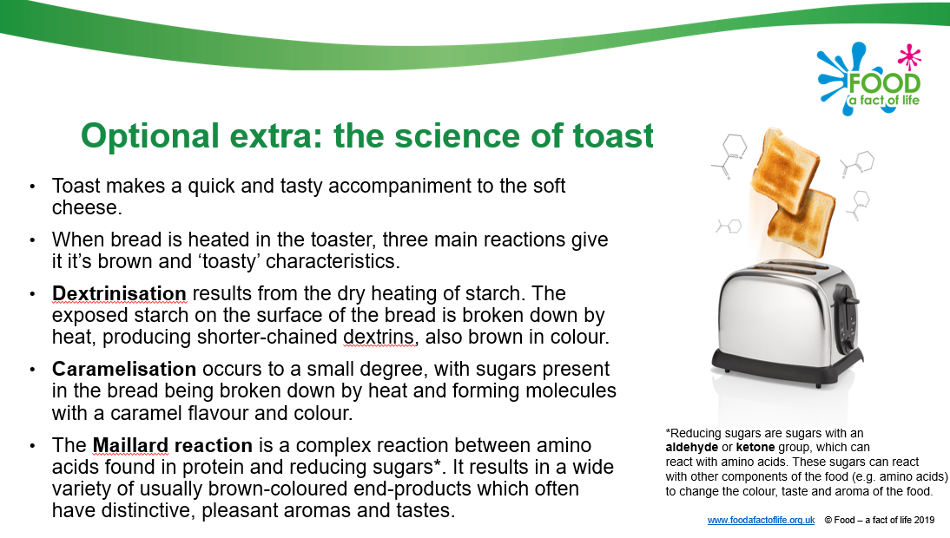
Resources to support this activity

Slide 25
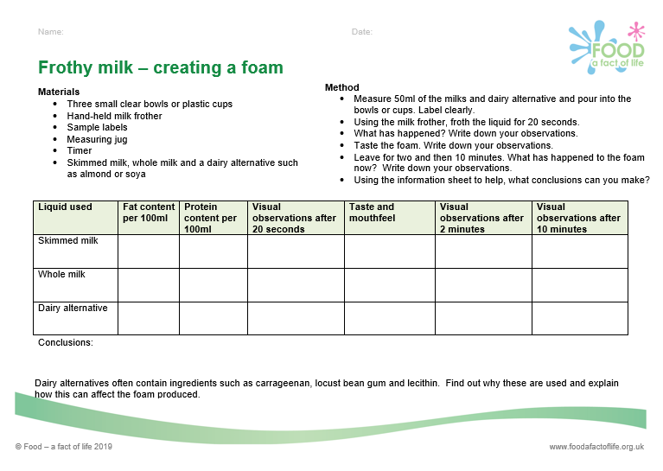
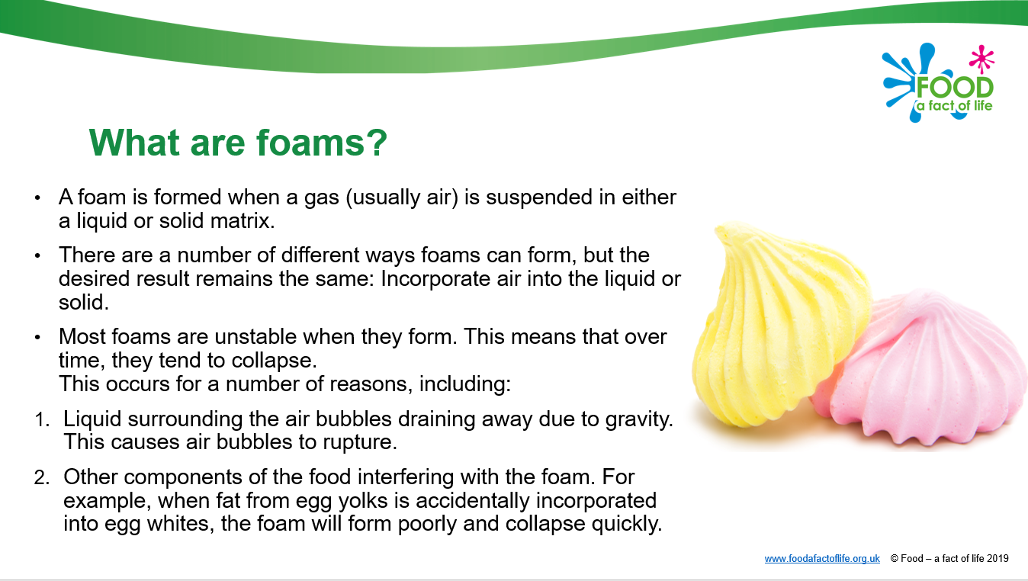
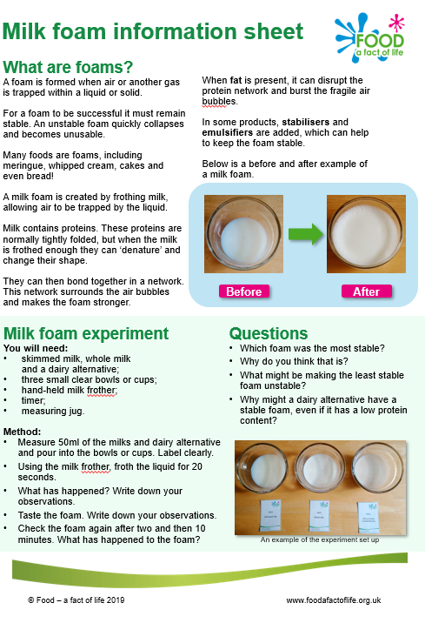
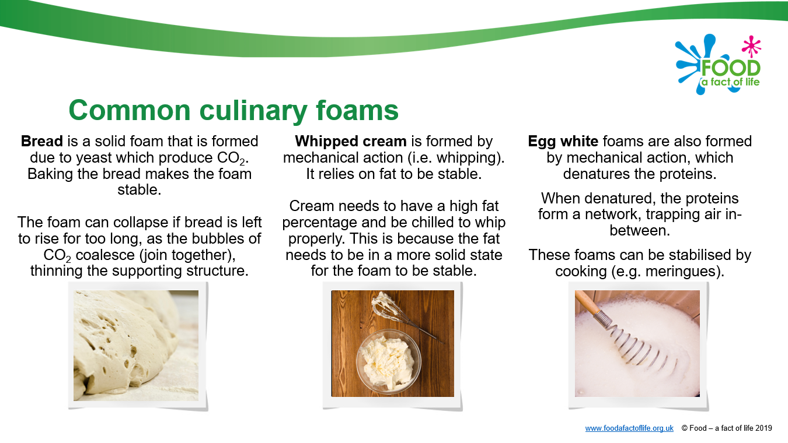
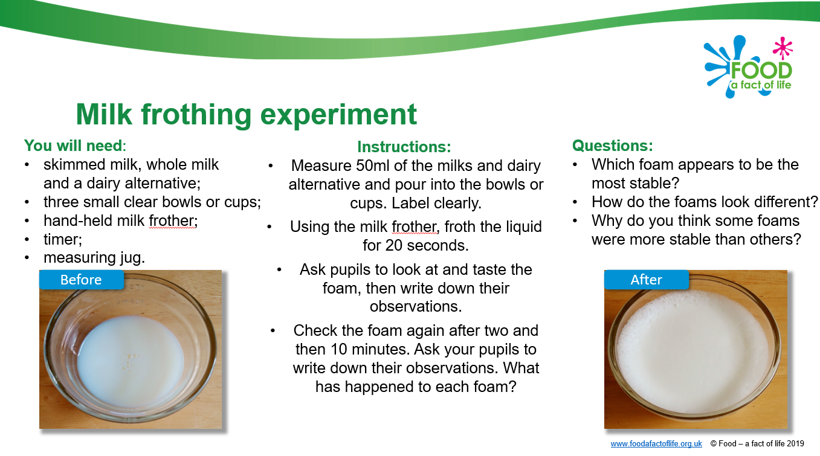
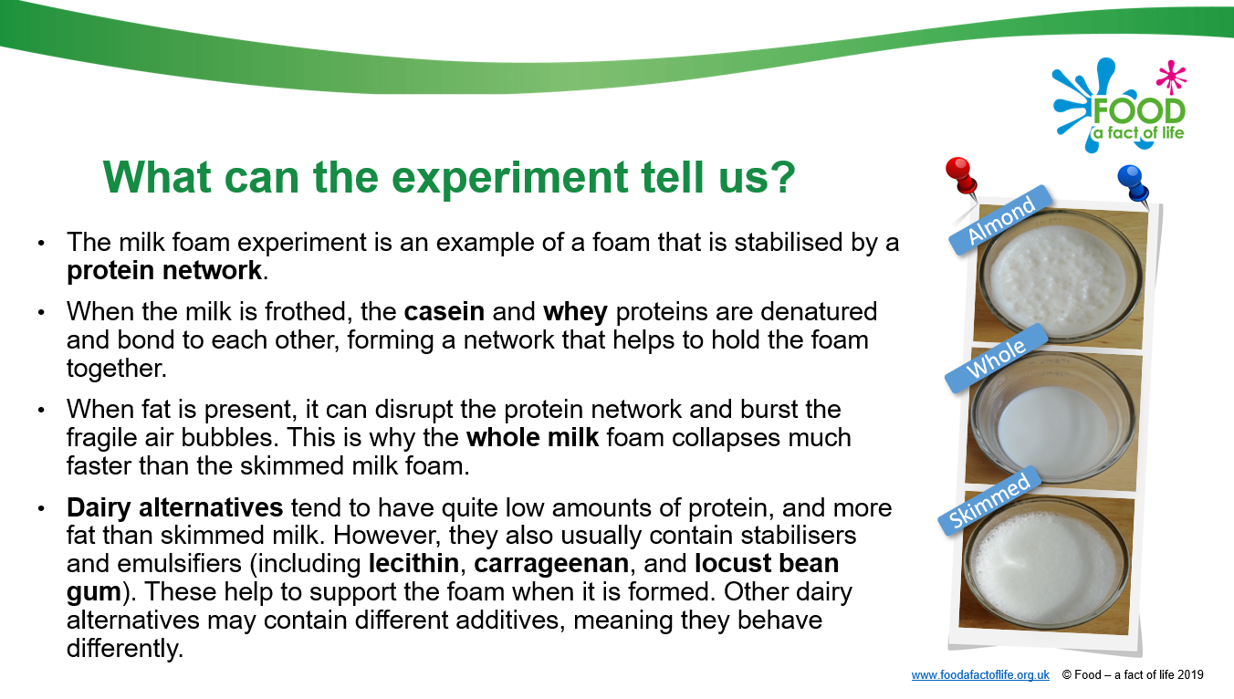
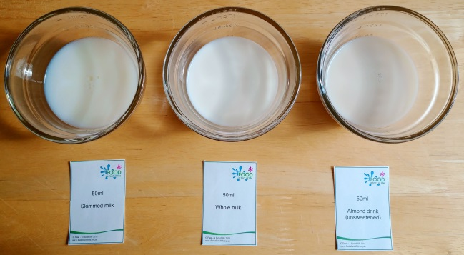
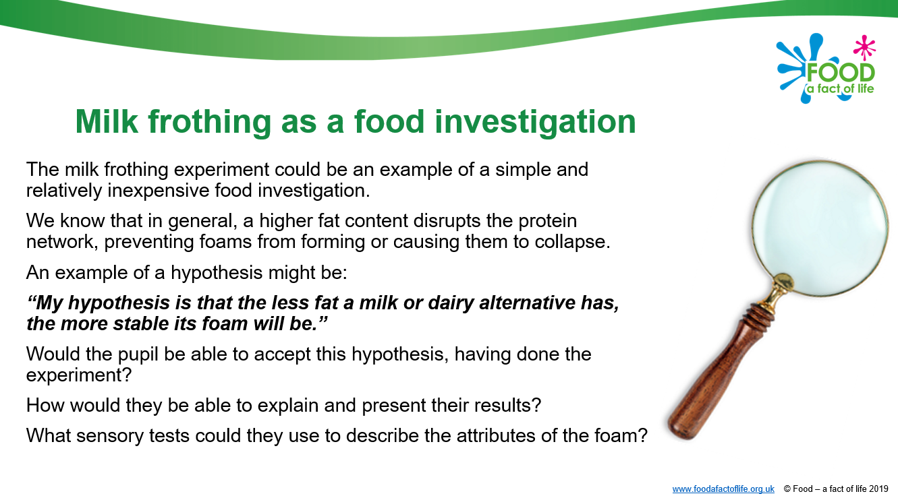
Frothy milk – making a foam
“My hypothesis is that the less fat a milk or dairy alternative has, the more stable its foam will be.”

Slide 26
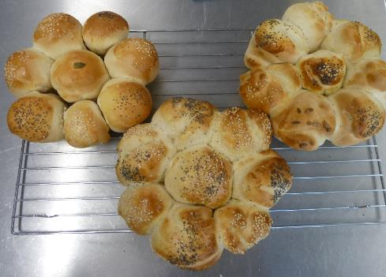
Popular KS3 recipes – bread making
Learning in lesson: focus on skill/knowledge, not recipe.
Quick medium complexity recipe that works well in the secondary classroom.
Made and cooked within an hour, ideal for shorter lessons.
Demonstrates a wide range of basic food skills but can be extended to allow for differentiation.
Uses ingredients that are easy to source, inexpensive and stored at ambient temperatures.
Nutrition science: Starchy carbohydrates in the diet.
Food science: Gluten formation, biological raising agents, the effect of cooking (coagulation, dextrinization, Maillard reaction), glazes
Sensory science: Testing, tasting and evaluation.

Slide 27
Activities and experiments
Explore the optimum conditions needed for yeast to work; comparing water temperature and the use of sugar.
https://www.foodafactoflife.org.uk/media/5035/biological-raising-agents.docx
Investigate the formation of gluten and the amounts of gluten in different flours by creating gluten samples.
https://www.foodafactoflife.org.uk/media/5052/gluten-formation.docx
Gluten experiment - a worksheet to investigate the gluten content of different types of flour.
https://www.foodafactoflife.org.uk/media/1306/gluten-experiment-ws-1114fcc.docx
A presentation explaining the effect dry heat has on starches (dextrinisation).
https://foodafactoflife.org.uk/media/6163/dry-heat-ppt-1114c2.pptx
A worksheet looking at the Maillard reaction.
https://foodafactoflife.org.uk/media/5029/maillard-reaction.docx

Slide 28
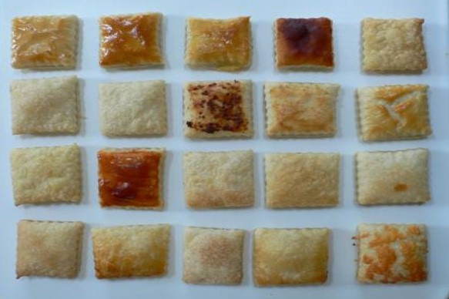

Glazes
Photo by
Barbara Monks

Slide 29
Resources
Presentation investigating the science of breadmaking.
https://www.foodafactoflife.org.uk/media/1299/the-science-of-breadmaking-ppt-1114fcc.pptx
Worksheet to record the different scientific principles involved in bread making.
https://www.foodafactoflife.org.uk/media/1304/bread-science-ws-1114fcc.docx
The science of breadmaking (14-16)
https://www.foodafactoflife.org.uk/media/9043/the-science-of-bread-making-1416.pptx
Varieties of wheat flour – a presentation showing different varieties of wheat flour
https://www.foodafactoflife.org.uk/media/1300/varieties-of-wheatflour-ppt-1114fcc.pptx
Making bread factsheet – a worksheet providing an overview of the ingredients used in breadmaking.
https://www.foodafactoflife.org.uk/media/1309/making-bread-the-facts-ws1114fcc.docx
Love Food Love Science (IFST) - useful information and link to video on gluten (KS4/AQA)
https://www.ifst.org/lovefoodlovescience/resources/protein-gluten-formation
ways to do this and tips to ensure success
Glazes

Slide 30
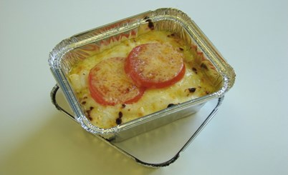
Popular KS3 recipes – macaroni cheese
A medium complexity recipe.
Demonstrates a wide range of basic food skills but can be extended to allow for differentiation and inclusion.
Basic roux sauce/method can be used in a variety of dishes.
Uses ingredients that are easy to source, inexpensive and mostly stored at ambient temperatures.
Nutrition science: Starchy carbohydrates and dairy in the diet, fibre in the diet (wholemeal pasta as an option).
Food science: Gelatinisation and coagulation.
Sensory science: Testing, tasting and evaluation.

Slide 31
Does the type of thickener make a difference?
Wholewheat flour has less starch per tablespoon than plain white so more would be needed.
Could make a ‘flour slurry’ and use this instead of cornflour – mix equal parts of flour and cold water and mix until smooth (in the same way as you would cornflour). Mixing with cold water first ensure the starch granules are separated and they are then less likely clump together and form lumps when they mix with the hot liquid.
Cornflour thickened sauces don’t freeze well as the starch granules can break down and syneresis occurs. Cornflour sauces should also not be boiled.
Cornflour sauces may form a skin.
Cornflour’s thickening capacity is greatly reduced in acidic environments (tomatoes, vinegar or wine) so plain flour should be used instead.
Arrowroot (also gluten free) thickens in the same way as plain flour and cornflour but needs to be used at lower temperatures. If it is overheated, the sauce returns to its thinner starting consistency – so not ideal for reheating.

Slide 32
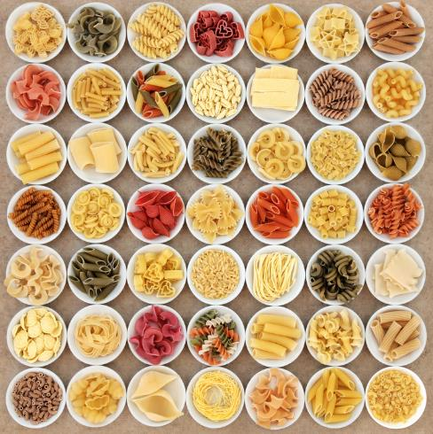
The science of pasta
Types of Pasta
Dried pasta is made from mixing wheat flour with water.
During cooking the pasta rehydrates by absorbing water.
The starches in the flour break down and gelatinise and the proteins denature and coagulate. The pasta softens.
Fresh pasta is made from mixing wheat flour and egg. It is soft and hydrated and therefore has a shorter cooking time.
The starch granules swell, break down and gelatinise.
The egg proteins denature and coagulate; the egg also contains emulsifiers which trap air inside the dough. This makes the pasta more buoyant which makes it rise to the surface as it cooks.

Slide 33
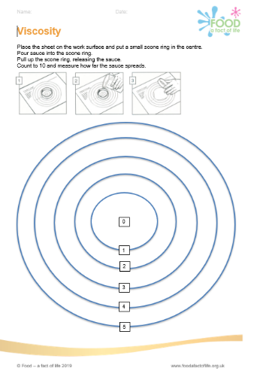
Activities and experiments
An investigation comparing the ingredients, cooking methods and viscosity of sauces.
https://www.foodafactoflife.org.uk/media/7209/cheese-sauce-experiment-ws-1114c2.docx
Note: To reduce waste you may wish to use the sauce sample to make/finish a dish or freeze for future use.
An experiment to measure the viscosity of different sauces, worksheet and viscosity chart.
https://www.foodafactoflife.org.uk/media/1301/viscosity-ws-1114fcc.docx
https://www.foodafactoflife.org.uk/media/6500/how-to-measure-thickness-or-viscosity-1416.docx
https://www.foodafactoflife.org.uk/media/1301/viscosity-ws-1114fcc.docx
A worksheet to explore the effect of using different amounts of flour on thickness
https://www.foodafactoflife.org.uk/media/1305/gelatinisation-ws-1114fcc.docx

Slide 34
Resources
A teacher's guide to a lesson looking at understanding sauces.
https://www.foodafactoflife.org.uk/media/6509/understanding-sauces-1416fc.docx
An information sheet on a roux sauce.
https://www.foodafactoflife.org.uk/media/6511/what-is-a-roux-sauce-1416.docx
A teacher's guide to a lesson on gelatinisation.
https://www.foodafactoflife.org.uk/media/6524/gelatinisation-lesson-plan-ws-1416.docx
A worksheet on gelatinisation.
https://www.foodafactoflife.org.uk/media/6502/investigating-gelatinisation-1416.docx
Information about gelatinisation.
https://www.ifst.org/lovefoodlovescience/resources/carbohydrates-gelatinisation

Slide 35
Activities and experiments
A practical session is to demonstrate enzymic browning and find out how enzymic browning can be prevented or reduced.
https://www.foodafactoflife.org.uk/media/5023/enzymic-browning.docx
A worksheet looking at the Maillard reaction.
https://www.foodafactoflife.org.uk/media/5029/maillard-reaction.docx
Resources – enzymic browning
https://letstalkscience.ca/educational-resources/stem-in-context/why-do-apples-turn-brown-after-you-cut-them
https://www.ifst.org/lovefoodlovescience/resources/fruit-and-vegetables-enzymic-browning
https://www.ifst.org/lovefoodlovescience/enzymic-browning-experimentshttps://www.ifst.org/lovefoodlovescience/enzymic-browning-experiments
Food science of marinades presentation
https://foodafactoflife.org.uk/media/6563/food-science-of-marinades-1416fcm.pptx

Slide 36
Food science principles and recipes
Learning intent – the science of food | Recipes to demonstrate the principle
Shortening | Crumble Scones Scone based pizza Shortcrust pastry Rockcakes Shortbread
Coagulation | Scrambled egg, Frittata, Quiche Fish cakes Bread, sponge cakes, biscuits
Denaturation – mechanical, chemical/acid, heat | Meringues (mechanical and heat) Marinated lamb kebabs (chemical) Yogurt (acid)

Slide 37
Food science principles and recipes
Learning intent – the science of food | Recipes to demonstrate the principle
Maillard reaction – amino acids from protein and reducing sugars | Roasted meat dishes Toast/toasted sandwiches
Dextrinistation - starches | Bread Pastry
Enzymic browning | Fruit kebabs Potato rosti Guacamole
Gelation | Fruit jelly
Glazing
Caramelisation | Crème caramel French onion soup

Slide 38
Other food science principles and recipes
Learning intent – the science of food | Recipes to demonstrate the principle
Foams | Meringues Swiss roll Bread
Emulsions | Mayonnaise Butter
Raising agents* – mechanical (adding air) | Swiss roll, creamed cakes, meringues, souffles Flaky pastry, rough puff pastry Scones
Raising agents - steam | Yorkshire puddings, choux buns
Raising agents – chemical | Irish soda bread Scones
*The different types of raising agents are sometimes used together to aerate a mixture. A creamed cake mixture is a good example.

Slide 39


Theory into practice
Resources and support from the Royal Society of Chemistry and IFST:
Royal Society of Chemistry: https://edu.rsc.org
IFST glossary https://www.ifst.org/our-resources/food-science-facts/food-science-glossary?page=3
IFST Love Food Love Science resources: https://www.ifst.org/lovefoodlovescience/resources

Slide 40




Royal Society of Chemistry: resources
https://edu.rsc.org

Slide 41
The appliance of science
For further information, go to:
www.foodafactoflife.org.uk
This resource meets the Guidelines for producers and users of school education resources about food.

